Slide 1
Backtracking Algorithm Implementation for Sudoku Solver
Jonathan Dervin, Roman Higginson, Zaryaab Qasmi

Slide 2
Abstract

Slide 3
Introduction

Slide 4
Background

Slide 5
Problem Statement

Slide 6
Objective

Slide 7
Methodology

Slide 8
Algorithm Overview

Slide 9
Implementation Details

Slide 10
Results

Slide 11
Performance Analysis

Slide 12
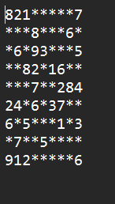
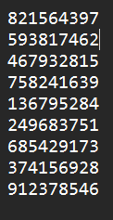
Puzzle 1
Number of Backtracks: 1516
Times
Run 1: 44.6 ms
Run 2: 60.5 ms
Run 3: 49.2 ms
Run 4: 47.2 ms
Run 5: 45.8 ms
Average Time: 49.5 ms
Difficulty:

Slide 13
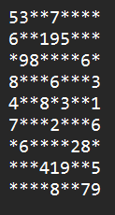
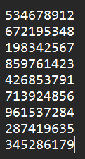
Puzzle 2
Number of Backtracks: 4209
Times
Run 1: 112 ms
Run 2: 116 ms
Run 3: 109 ms
Run 4: 115 ms
Run 5: 116 ms
Average Time: 49.5 ms
Difficulty:

Slide 14
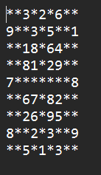
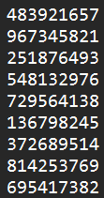
Puzzle 3
Number of Backtracks: 1516
Times
Run 1: 44.6 ms
Run 2: 60.5 ms
Run 3: 49.2 ms
Run 4: 47.2 ms
Run 5: 45.8 ms
Average Time: 49.5 ms
Difficulty:

Slide 15
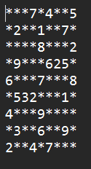
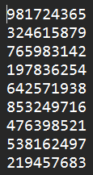
Puzzle 4
Number of Backtracks: 1516
Times
Run 1: 44.6 ms
Run 2: 60.5 ms
Run 3: 49.2 ms
Run 4: 47.2 ms
Run 5: 45.8 ms
Average Time: 49.5 ms
Difficulty:

Slide 16
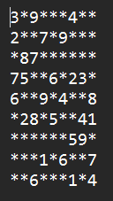
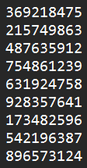
Puzzle 5
Number of Backtracks: 1516
Times
Run 1: 44.6 ms
Run 2: 60.5 ms
Run 3: 49.2 ms
Run 4: 47.2 ms
Run 5: 45.8 ms
Average Time: 49.5 ms
Difficulty:

Slide 17
Discussion

Slide 18
Efficiency Evaluation

Slide 19
Limitations

Slide 20
Conclusion

Slide 21
Summary of Findings

Slide 22
Recommendations

Slide 23
References

Slide 24
Additional Material

